Slide 1


Slide 2
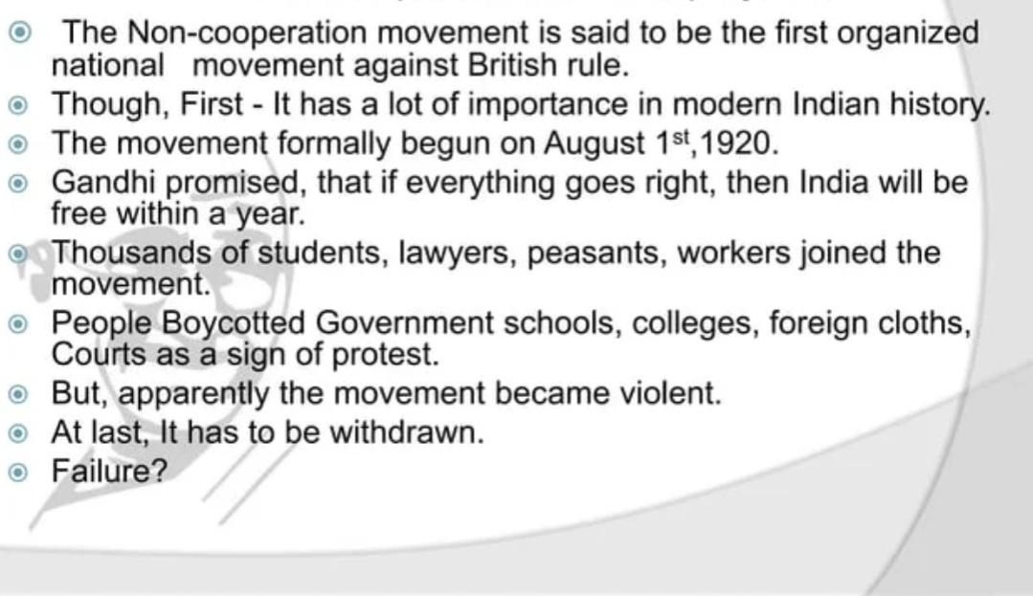
INTRODUCTION

Slide 3
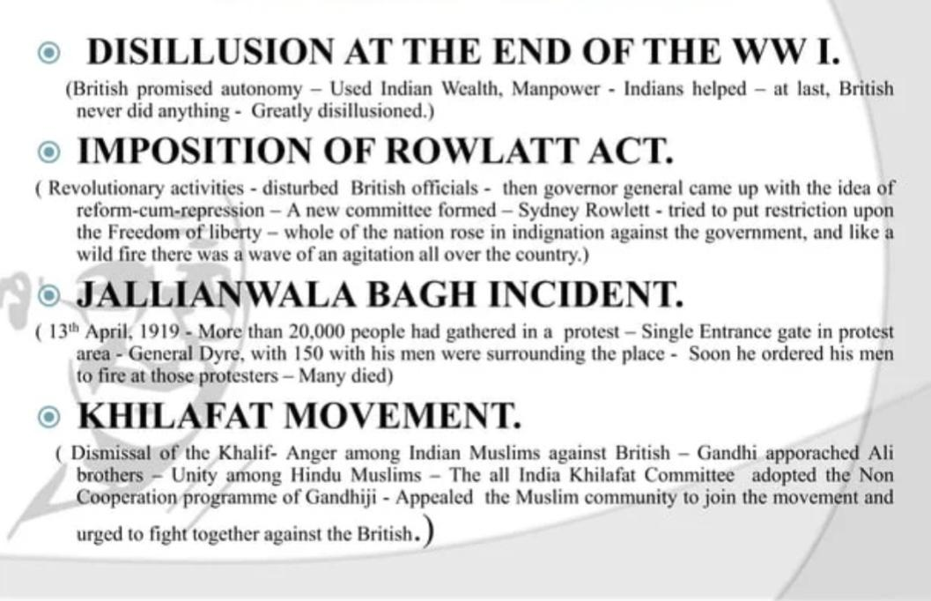
CIRCUMSTANCES LEADING TO THE NON COOPERATION

Slide 4


Slide 5
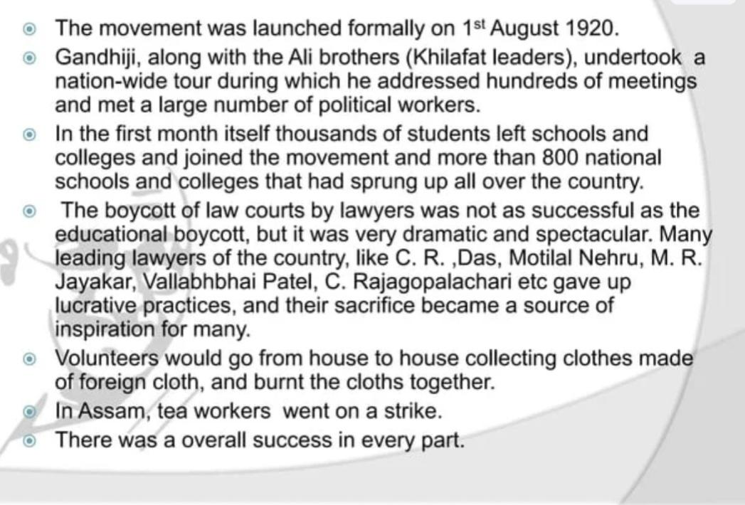
STARTING OF THE MOVEMENT

Slide 6
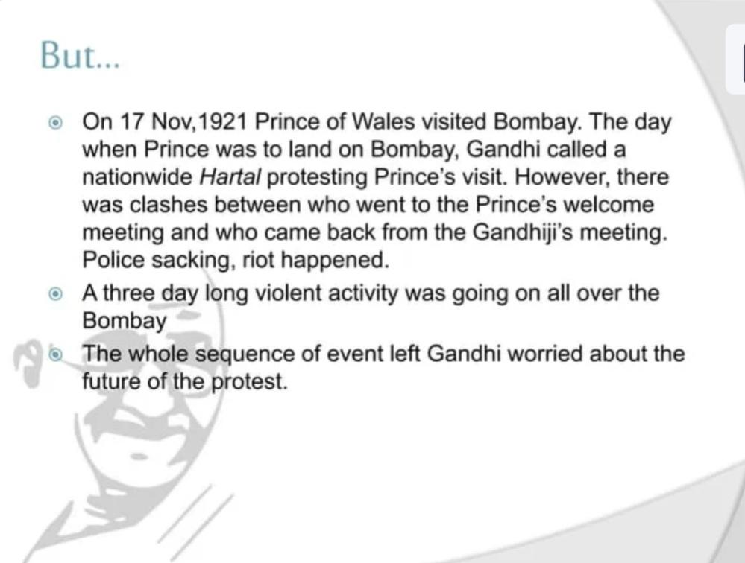

Slide 7
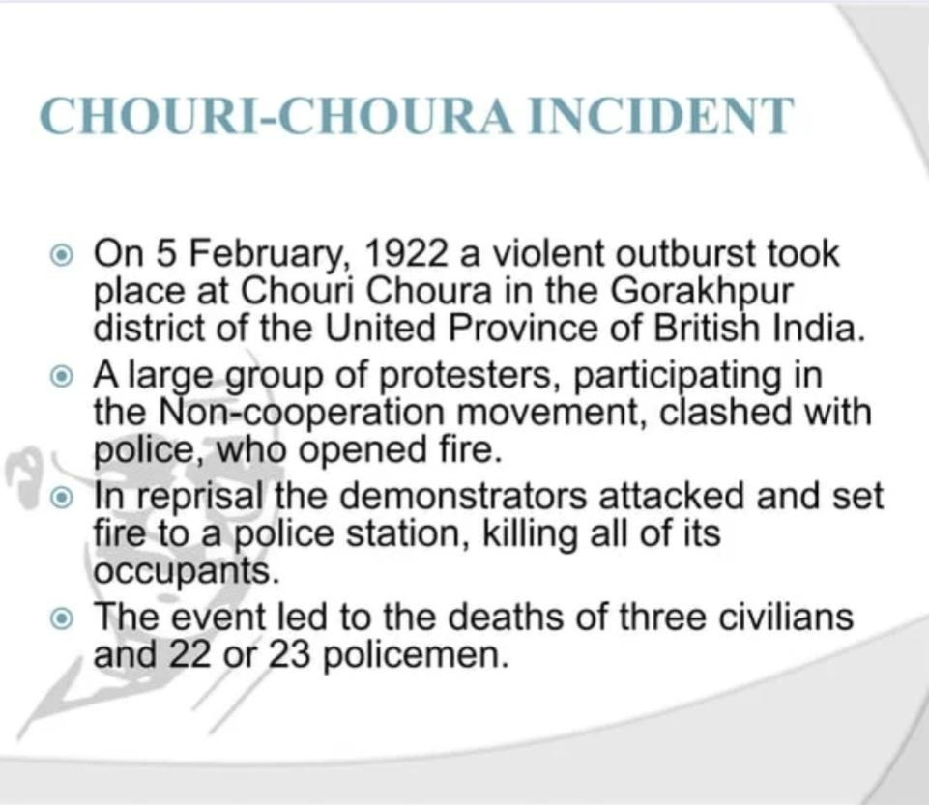

Slide 8
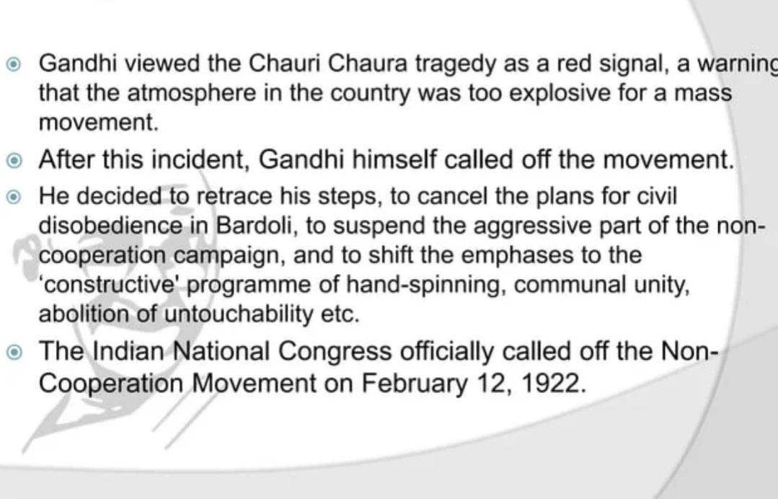
SUSPENSION OF THE MOVEMENT

Slide 9
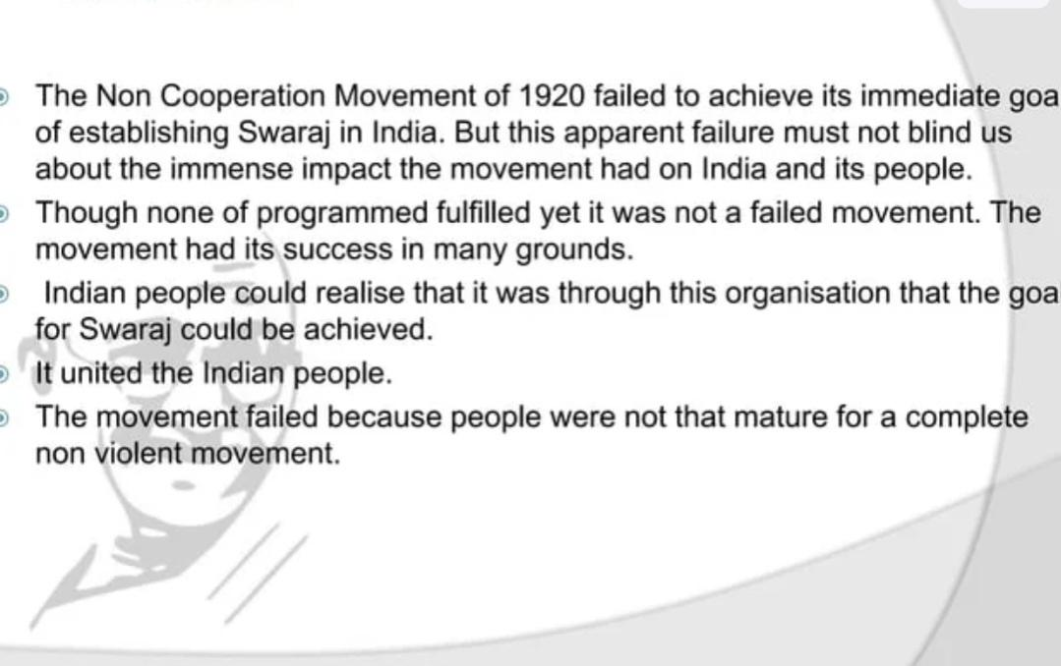
CONCLUSION

Slide 10
THANK YOU

